Slide 1
Capstone Project -1
Playstore App Review Analysis
Vartika Arora
Student at Alma Better

Slide 2

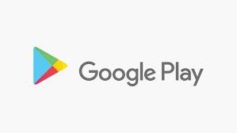
INTRODUCTION
Google Play Store is a home to millions of applications or apps as we call it, here you can download or buy apps, games, and other media onto your Android device.
In this exploratory data analysis done on a sample data set of around 10k apps from google play store. The aim is to draw some insights of the general app distribution among various categories and genres , studying the relation between app size, its type, and other possible factors that affects the popularity of the app.

Slide 3
TABLE OF CONTENTS
Category wise distribution of apps
Most popular categories
Distribution of apps in different size groups
Studying relation between app size , its type and its influence on app rating
Percentage distribution of apps by content rating
Reviews sentiment analysis
Top 10 most positively and negatively reviewed apps
Distribution of app by its type(Free/Paid)
Studying Top 10 most expensive and least expensive paid apps on Playstore.
Summary

Slide 4
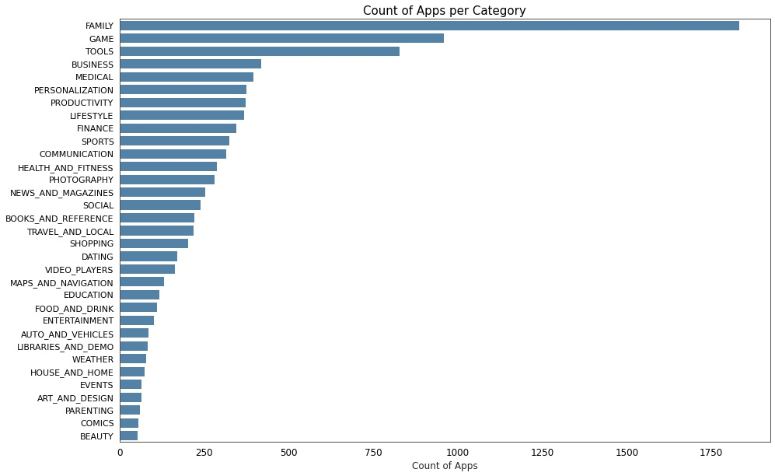

Slide 5
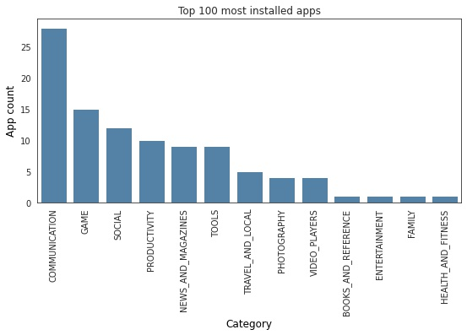
Top 100 Installed Apps
As previously seen the top 5 categories that majorly contribute to the playstore apps are Family, Games, Tools, Medical and Business category.
However the categories that dominated the most installed apps are communication , games, social and tools.

Slide 6
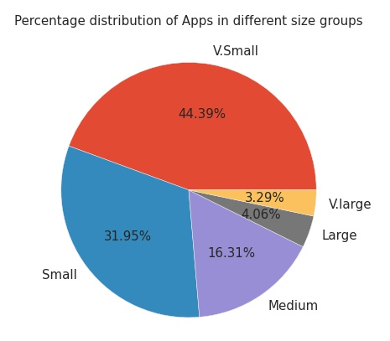
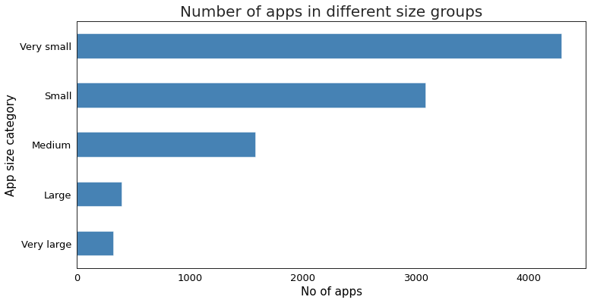
0-10 mb Very small
10-30 mb Small
30-60 mb Medium
60-80 mb Large
80 mb > Very large
Maximum apps in Playstore are light apps and have size between 0-10 mb , followed by small apps having size between 10 –30 mb . Percentage of heavy apps that are and above 80 mb is only 3.29 percent.

Slide 7
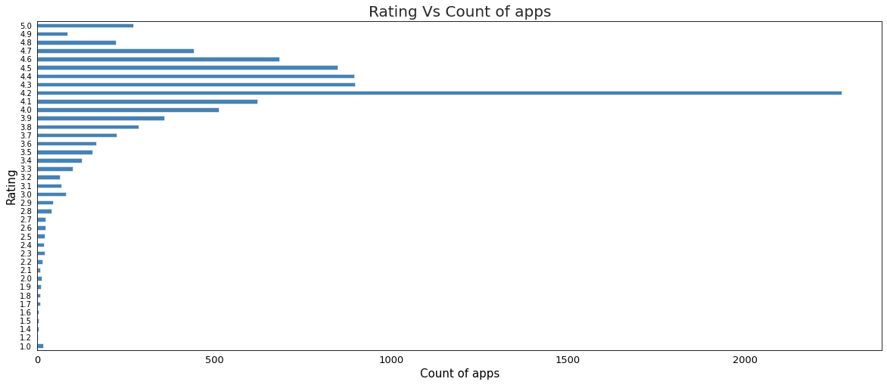
Maximum apps have an average rating of 4.1 and majority apps have a good average rating (4.1-4.6).

Slide 8
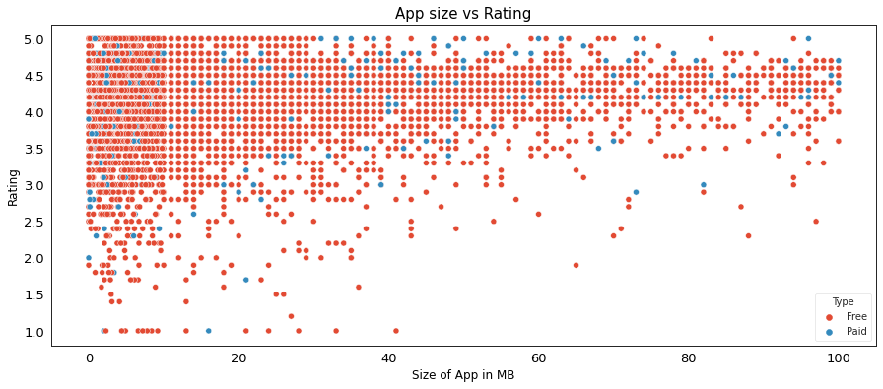
After observing the scatter plot, we see that majority of the apps are small in size and have good average rating.
On more close observation we can see apps with more data size mostly have good rating.
Hence, we can infer that the apps which have more data size have better performance, resulting in better user experience and Apps that are free also has positive impact on user's choice and preference.

Slide 9
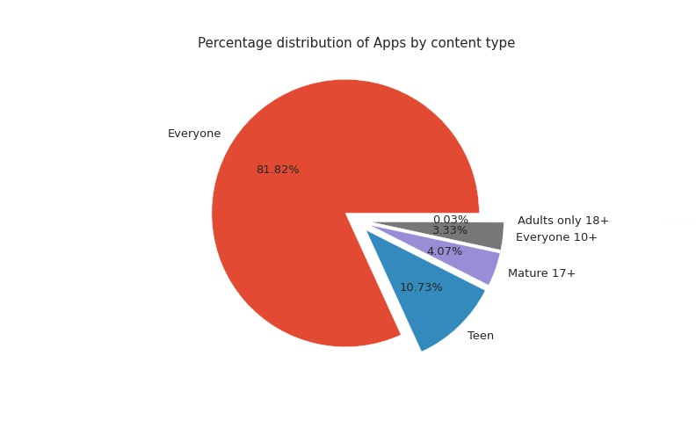
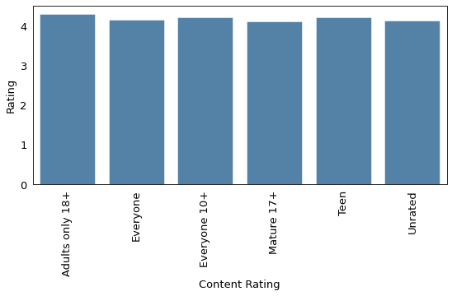
On observing the average rating for each content category we see all the categories have almost same average rating .
A large portion of total apps available on playstore is rated for everyone and have a large and diverse user base .

Slide 10
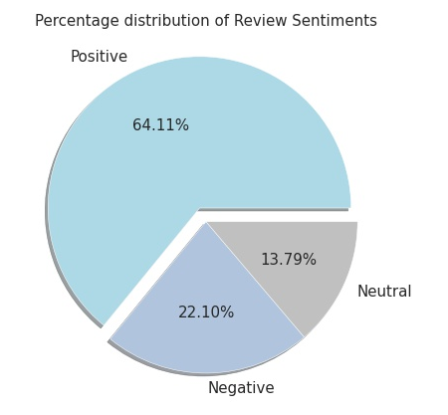
USER REVIEWS
According to research from Apptentive 90% of users check reviews before downloading an app.
Reviews have an influence on the app store algorithms and how visible your app is to customers. The more positive reviews you have the more the algorithm will promote your app.
Reviews also helps in highlighting issues that can be resolved for much better user-friendly experience of the app.
Additional features and products can then make a real difference to your customer experience and your overall growth.

Slide 11
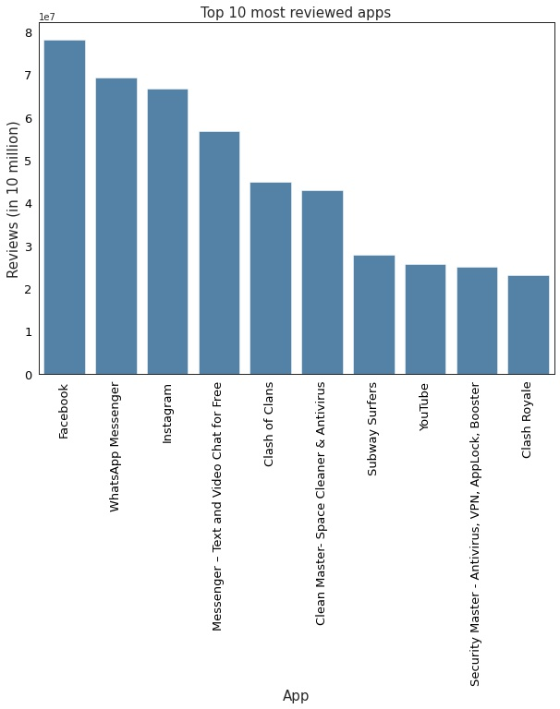

Slide 12
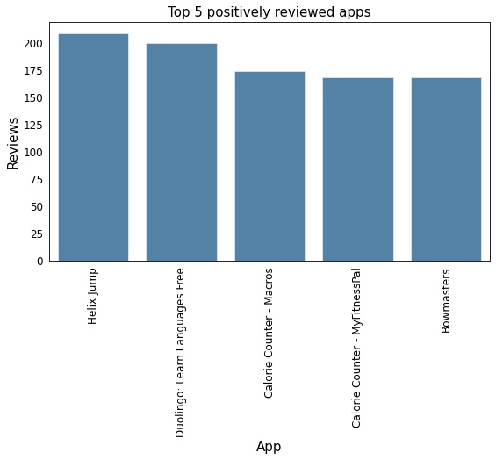
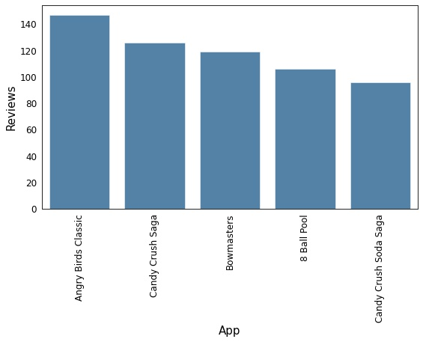
Top 5 negatively reviewed apps

Slide 13
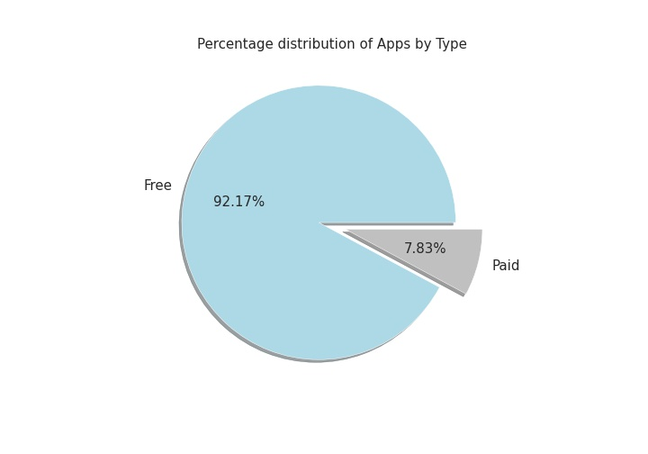
A major chunk of the total apps available on Google Playstore are free apps . i.e. the user don’t have to purchase the app and the main source of the revenue generated by the apps is through adds. Whereas, only 7.83 percent apps available are the paid apps .
In the given data set the most expensive app is for $400.0 and least expensive is for $0.99.
All the Apps in the paid category lies in this price range.

Slide 14
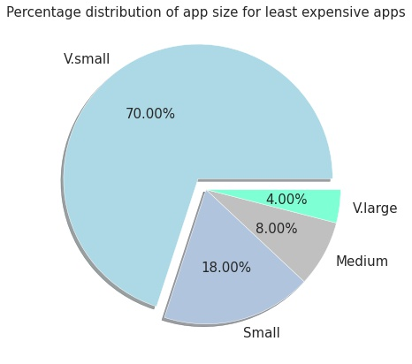
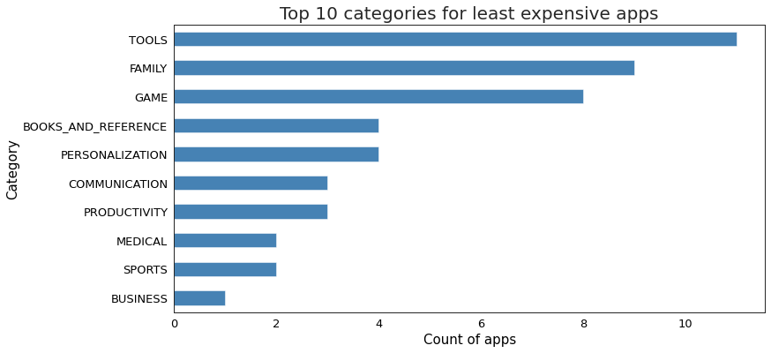
In the paid category , A subset of 50 least expensive apps(mostly which were below $10.0 ) was observed . It is seen that top categories with least expensive paid apps are Tools, Family and Games.
And majority of these apps are very small in size.

Slide 15
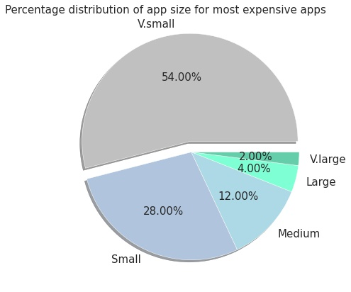
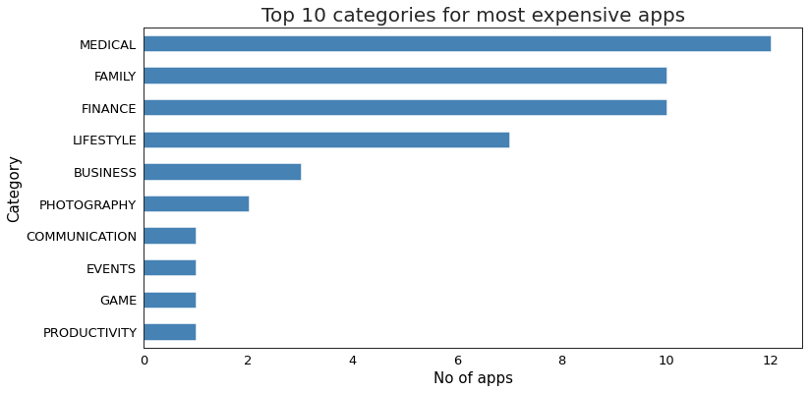
In the paid category , A subset of 50 most expensive apps(ranging b/w $30.0 to $400.0 ) was observed . It is seen that top categories with most expensive paid apps are Medical, Family and Finance.
Majority of most expensive apps are also very small in size.

Slide 16
SUMMARY
The top 5 categories that majorly contribute to the playstore apps are Family, Games, Tools, Medical and Business category.
Whereas, Beauty, Comics, Parenting, Art and Design, and Event categories have the lowest share in the total playstore apps.
The top 100 most installed apps/popular apps are free apps majorly belongs to Communication, tools, games ,social and family category.
There are 92.17% free and 7.83% paid apps in the playstore.
The top 5 most reviewed apps are Facebook, WhatsApp Messenger, Instagram, Messenger – Text and Video Chat for Free and Clash of Clans
Helix Jump has the highest number of positive reviews and Angry Birds Classic has the highest number of negative reviews.
Apps in paid category lies between range of $0.99- 400.0 . Top categories having most expensive apps are medical, family , finance, lifestyle and Top categories having least expensive apps are Tools, family and games.
81.82 % apps in playstore is rated for everyone, 10.73% for teen , 4.07% for mature 17+, 3.33% for 10+ and 0.03 % rated only for adults 18+
Around 75 % apps in playstore are light apps , 16.31 % medium and ~7% apps are heavy apps.
80.23 % apps in playstore are top rated having average rating above and equal 4.0 and only 0.61% apps are lowest rated having average rating less than 2.0

Slide 17
ANALYSIS
All the top 100 apps installed are free apps and mostly belongs to communication , games and tools category. Hence, we can infer that if an app is free it will have larger and diverse user base.
We have observed that there is large user base of social, communication and games categories but there are not many apps available in these categories except for games. Hence, social and communication are the categories that can be tapped more.
If the app has content rating not for everyone, it will not have a large user base but if you make it more user centric targeting the selective audience the app will do well even if it is paid then.
Majority of the apps in playstore are small in size and have good/above average rating. While for paid apps, we have almost equal distribution in terms of size and rating.
On more close observation we can see apps with more data size are also given good rating.
Hence, we can infer that the apps which have more data size have better performance, resulting in better user experience and Apps that are free also has positive impact on user's choice and preference.

Slide 18
References
https://github.com/
https://www.geeksforgeeks.org/
https://www.w3schools.com/

